Slide 1

Beating the Market with AI
Presented by :
Jason , Majid, Justin, Ragini , Souk

Slide 2

Table of Contents
Scope and Purpose
Project Approach
Strategies used for Testing
Models Explored
Sources for Data Collection
Techniques used
Model Framework
Conclusions
Next Steps
Testing & Evaluating the models performance

Slide 3

Scope and Purpose
To identify the best feature sets and model for real-world usage in finance.
Multiple machine learning models spanning two stocks were analyzed.
The project's objective is to determine whether model can train and perform tests on one stock while maintaining performance when tested on a different stock.

Slide 4
Project Approach
UseD trading algorithms and AI to identify the best model for trading.
Libraries: Pandas, matplotlib, NumPy, TA lib, scikit-learn
The ideal use of this project is to use the final results and analysis to determine ideal models for other projects and real-world applications.

Slide 5

Strategies Used for testing
Triple EMA crossover strategy,
RSI,
MACD indicators, single 7-Day EMA

Slide 6
Models Explored
Three Models explored
Multi-Layer Perceptron (MLP)
Extra Trees Classifier
Gradient Boosting Classifier

Slide 7

Sources for Data Collection
Using Yahoo Finance, stock data were extracted from CSV files.
Taken historical data (2012-2022) and it was a cleaned data.

Slide 8

Demonstrations

Slide 9

Techniques Used
Created signals algorithm to identify when 7 Day EMA is above the 14 & 28 day to generate a buy signal.
Used the first 6 months of 2012 AAPL stock data to train the models
Notes:
Update this from slack

Slide 10
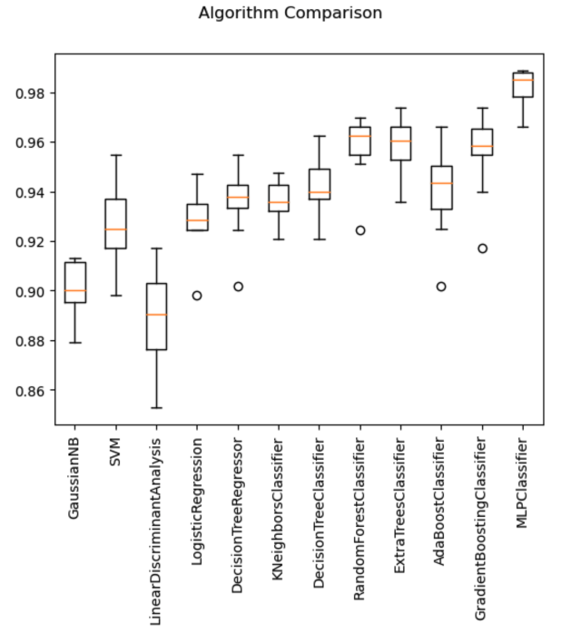
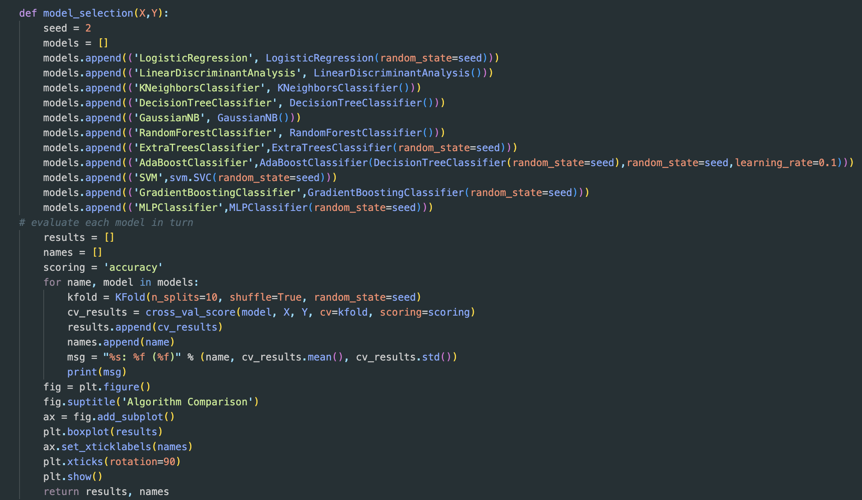
Model Framework
The top three models chosen were the : MLP Classifier, Extra Trees Classifier, and Gradient Boosting Classifier. The three models were trained and tested on Apple stocks
The models were then tested on Microsoft without retraining to identify whether the trained model can be used on other stocks and help identify patterns and possible overfitting
Notes:
Suggestions from team
Note: Updated from the ReadMe file

Slide 11
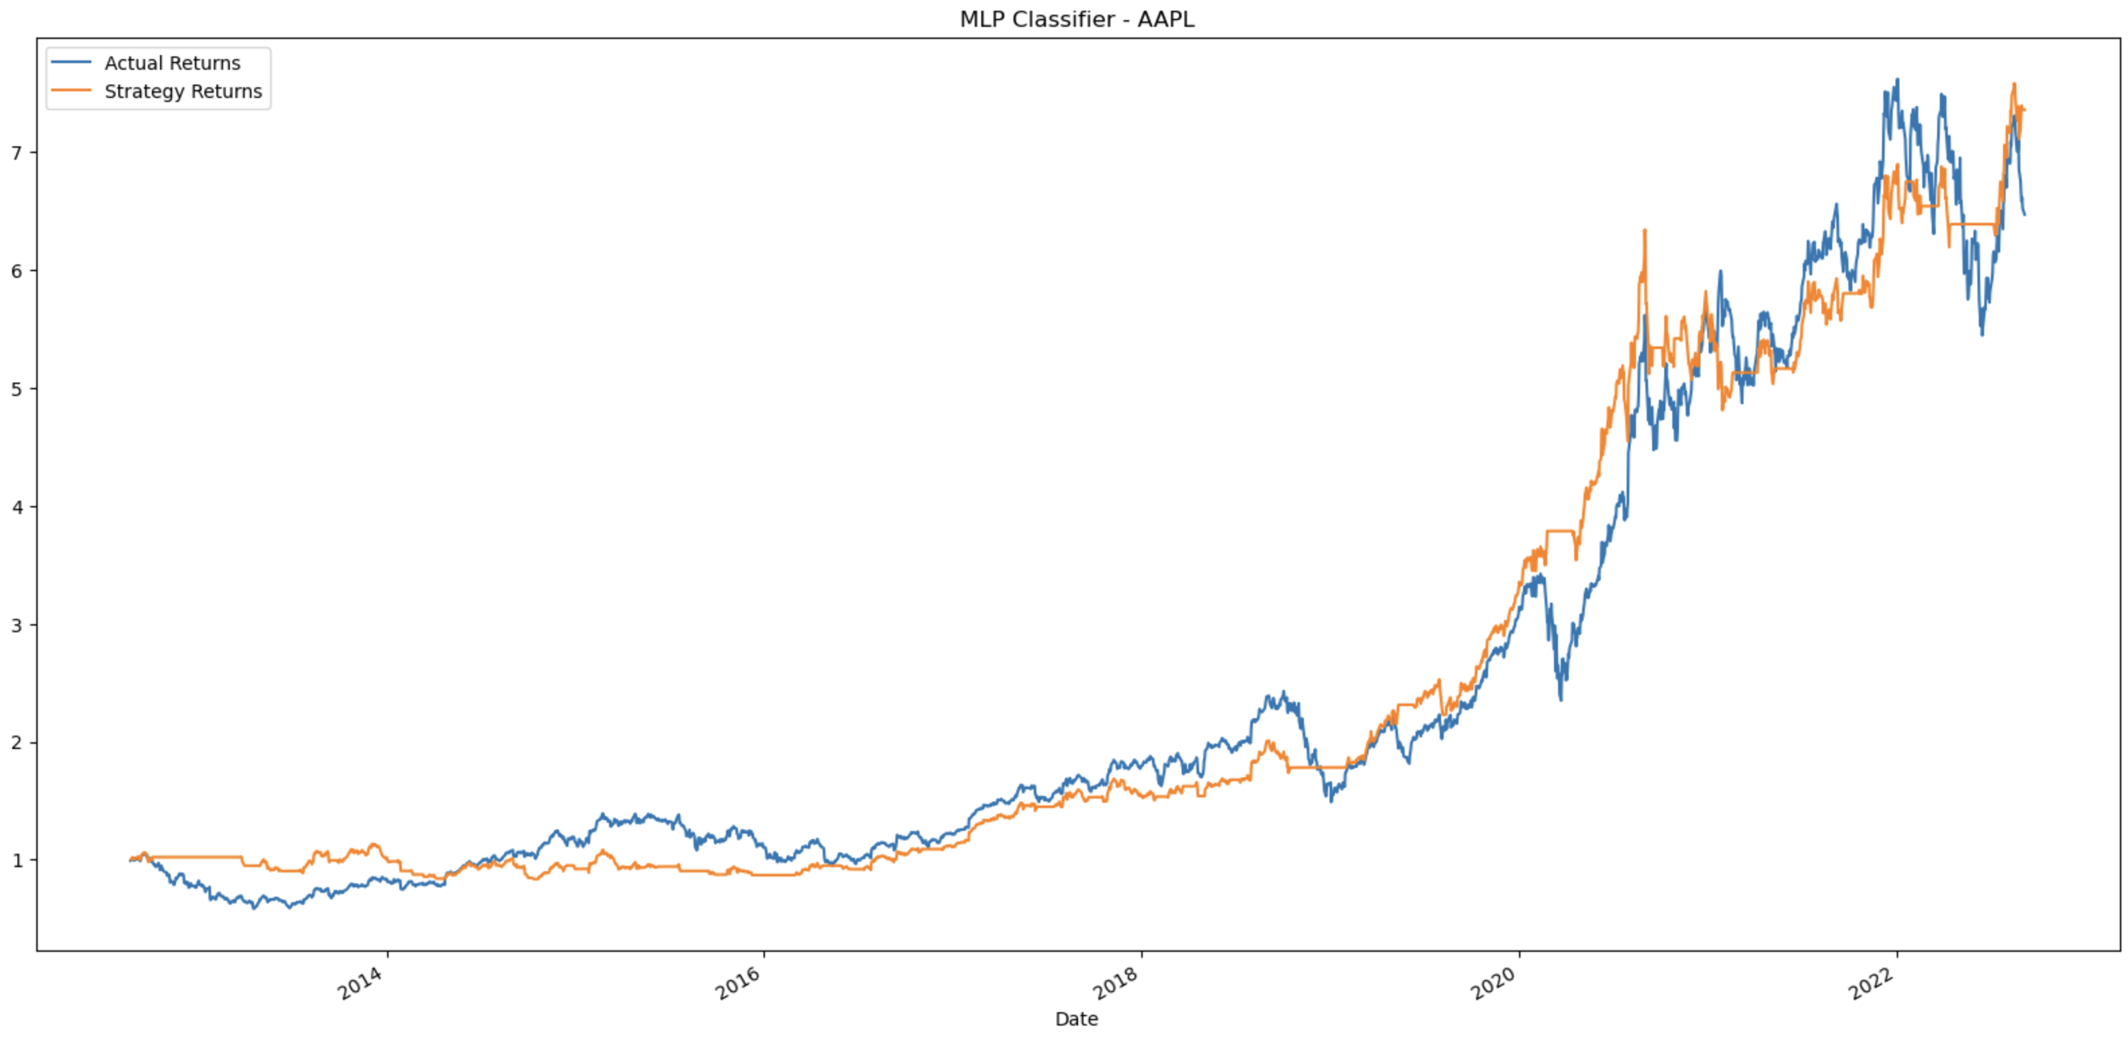
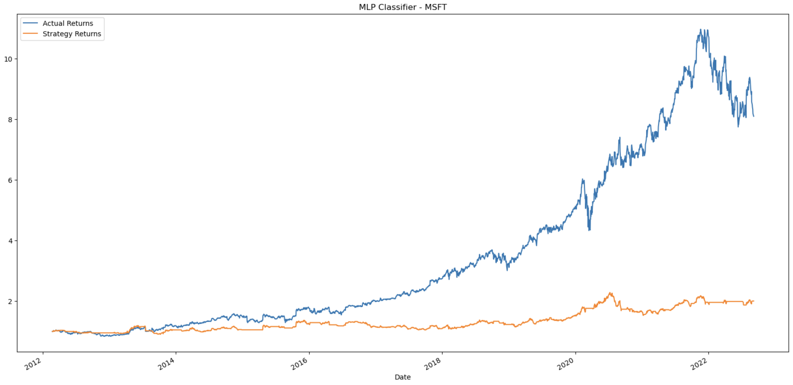
Multi-Layer Perceptron (APPL vs MSFT)

Slide 12
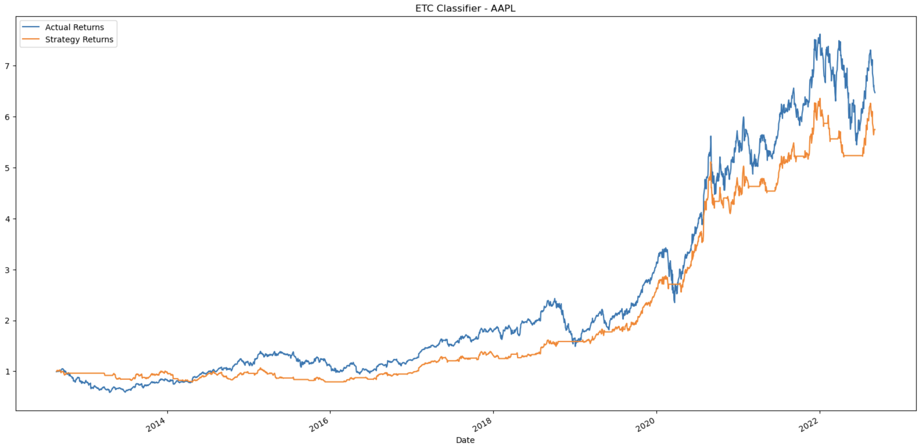
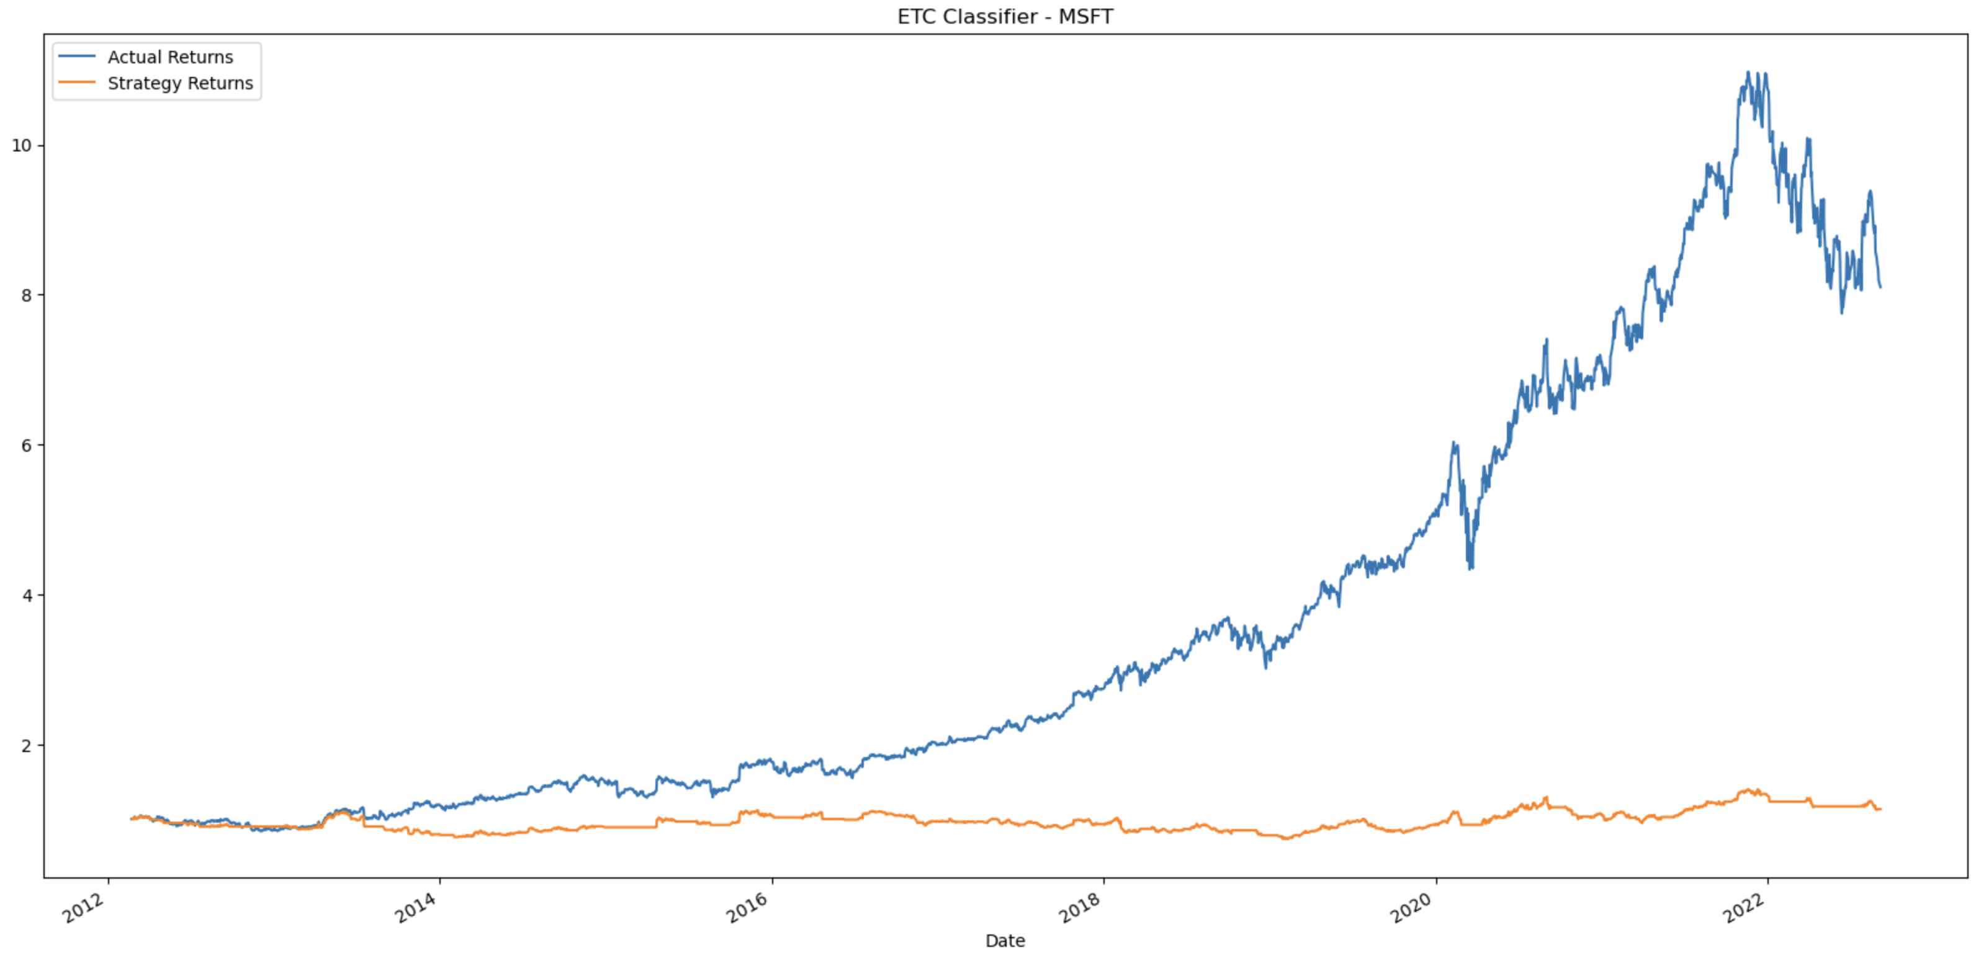
Extra Trees Classifier (APPL vs MSFT)

Slide 13
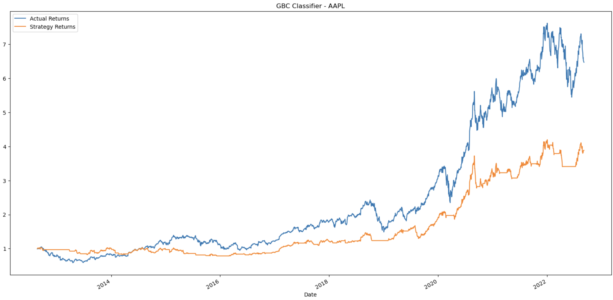
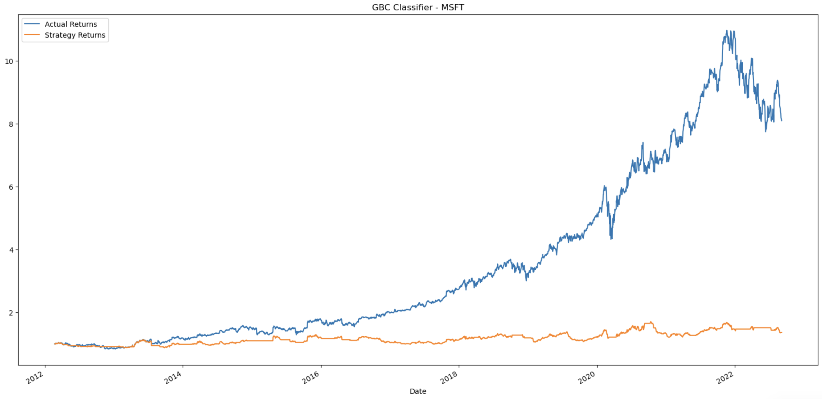
GBC model (APPL vs MSFT)

Slide 14
Testing & Evaluating the models performance
Tested various other configurations and found that the major performance issues were the initial algorithm and indicators used to train the models.
There was similarly poor performance with Microsoft prior to using the models.

Slide 15

Multi-Layer Perceptron (MLP) worked quite well. The only major performance issues were the initial algorithms and indicators used to train the models. Need to focus on these two issues in the next steps.

Slide 16

Next Steps
Further testing and optimization of the algorithms used to generate the signals and the indicators may lead to more positive results.

